Slide 1
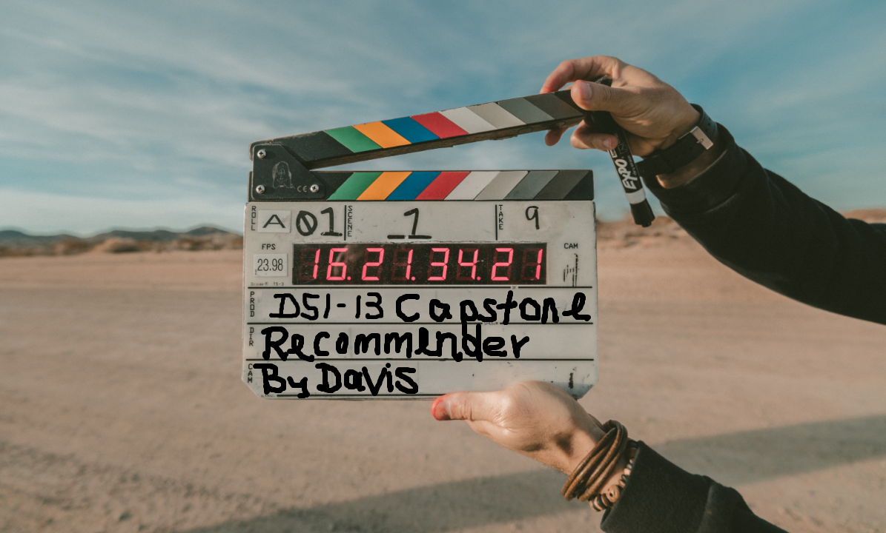
DSI-13 Capstone Project
Movie Recommender System
By Davis Hong

Slide 2

Problem Statement
Nowadays, users have very short attention span. With more and more players coming into the online video contents space, an effective RS is a must.
Besides Netflix, Amazon Prime, YouTube, Cast and many unheard of – Roku, Hulu, Sony Crackle, etc are eager to get a share of the pie.
Netflix understood the importance of a good RS. Just by increasing the accuracy rate by a few % will bring in $$$

Slide 3
Problem Statement (con’t…)
Objective: Develop and identify the best RS for recommending movies that;
is fast and responsive
is able to predict users’ preference fairly accurately and make recommendations
easy to measure performance

Slide 4
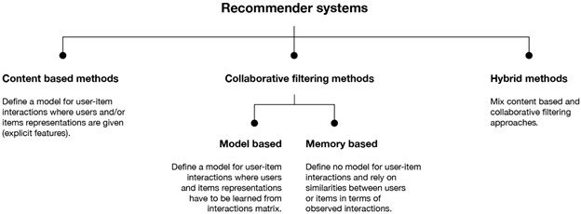
Introduction to RS
The below are the various recommender systems (RS) currently used by content providers, online retailers, etc.

Slide 5

Introduction (con’t…)
All 3 modeling approaches will be used for this project.
Content-Based Filtering makes recommendation based on user’s shopping and browsing habits
Collaborative Filtering based on user-to-user or item-to-item to make recommendations
Hybrid Filtering combines Content-Based and Collaborative Filtering for better results

Slide 6



EDA and Data Munching
MovieLens datasets will be used
Cleaning is required as the datasets are clean
EDA shows that movie title on Night Love triumphs it all
Drama, comedy and action genre are the hot picks

Slide 7

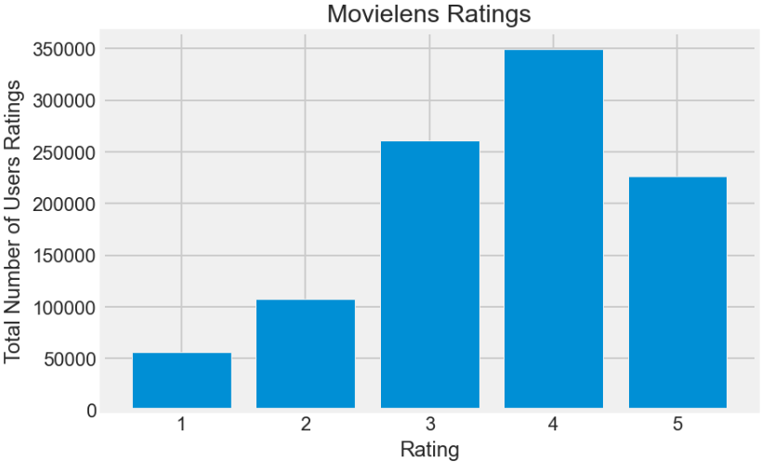
EDA and Data Munching (con’t…)
Majority of the ratings fall in the 4-star category
It is a negatively skewed distri-
bution (Mode > Median > Mean)
The ratings may not be a good
indicator whether the movie is
good or not as different people
have different rating style

Slide 8

Modeling
A simple model using cosine similarity with TF/ IDF added subsequently to see recommender in action
The below models were developed;
Popularity
Collaborative Filtering
Content-Based Filtering
Hybrid (a combination of Collaborative and Content based filtering)

Slide 9
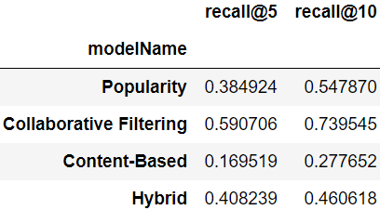
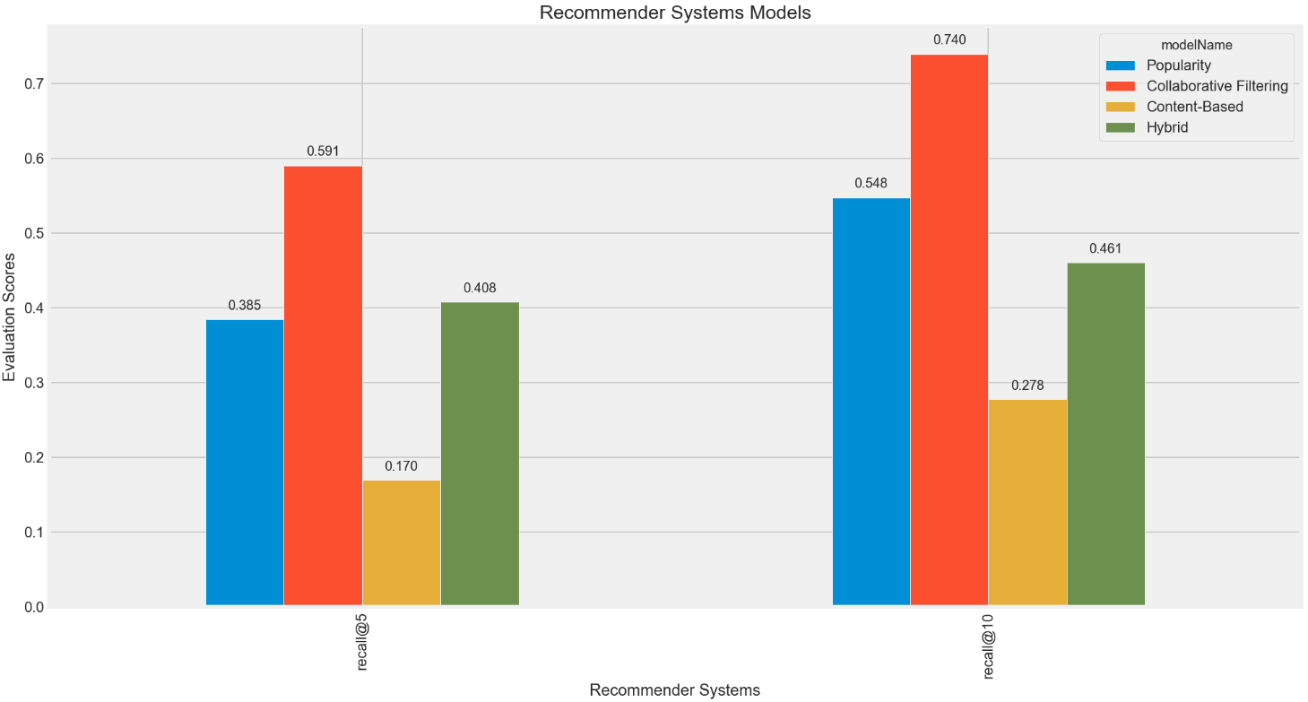
Evaluation of models
Top-N accuracy Recall@N metrics was used to evaluate the 4 models. Clearly, collaborative filtering is the best.

Slide 10
Conclusions and Recommendations
Based on metrics, business should implement a RS using collaborative filtering.
Explore other algorithms such as ALS, KNN, CCO, etc that may yield better performance.
Able to evaluate performance of a RS other than using metric is very important. Business can consider using A/B testing, Click-Thru-Rate and Conversion Rate.

Slide 11
Conclusions and Recommendations (con’t…)
Use ROI, monitor churn rate, customer retention rate or even customer analytics to measure RS performance.
A better approach is to provide good customers’ experience so that they keep coming back by recommending a small portion of non-related items that otherwise hidden from the user.
*** The End ***

